Slide 1
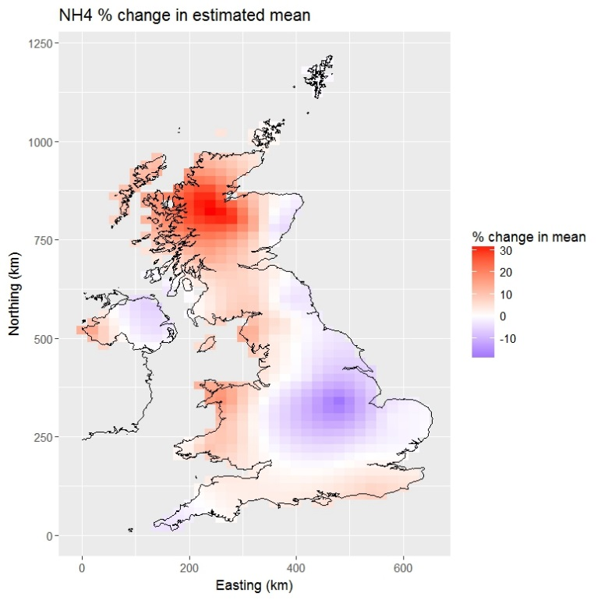
SPATIAL &
spatio-temporal
ANALYSIS – PART II
BAYESIAN COURSE, CEH SEPTEMBER 2019

Slide 2
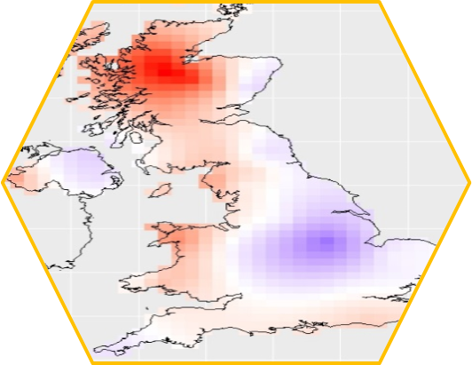
PART II – SPATIO-TEMPORAL ANALYSIS
SPATIAL & SPATIO-TEMPORAL
CONTENT & Learning outcomes
Temporal dependency
Introduction to spatio-temporal problems
Examples
In practice (software/packages)

Slide 3
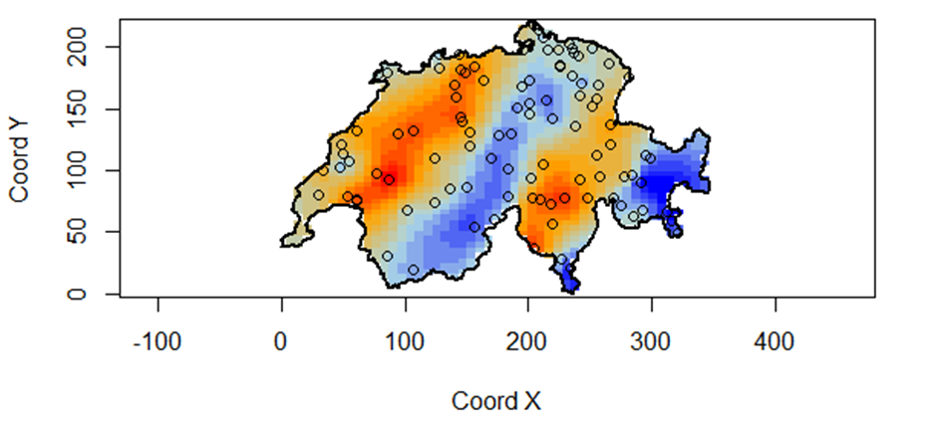
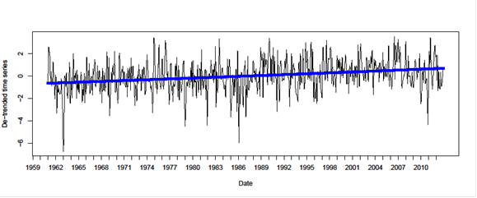
SPATIO-TEMPORAL ANALYSIS
SPATIAL & SPATIO-TEMPORAL

Slide 4
SPATIO-TEMPORAL ANALYSIS
SPATIAL & SPATIO-TEMPORAL
FUSING SPATIAL STATISTICS AND TIME SERIES METHODS

Slide 5

TEMPORAL Dependence
SPATIAL & SPATIO-TEMPORAL
Assuming correlation between time points (t, s) is constant over time, the only factor affecting correlation is ‘distance’ between time points i.e. the lag:
Sample autocorrelation function, varying -1 to 1:
Often we may expect the correlation to be positive.

Slide 6
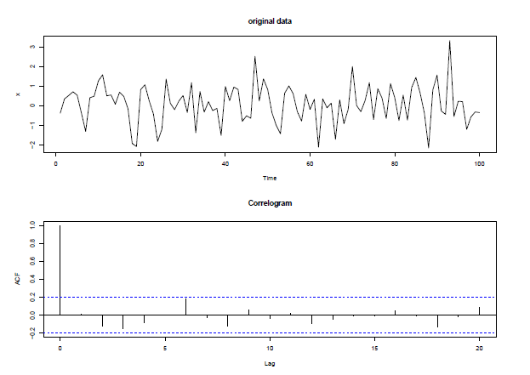
TEMPORAL Dependence
SPATIAL & SPATIO-TEMPORAL
Dashed lines are approximate 95% CIs

Slide 7
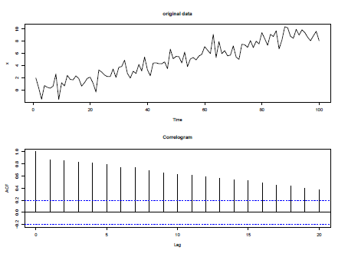
TEMPORAL Dependence
SPATIAL & SPATIO-TEMPORAL
Trend masks short term correlation

Slide 8
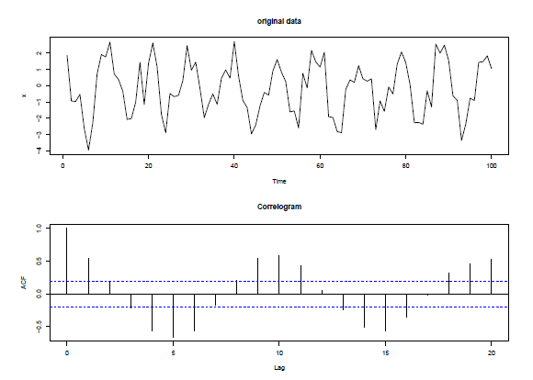
TEMPORAL Dependence
SPATIAL & SPATIO-TEMPORAL

Slide 9
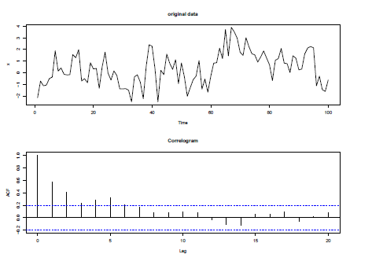
TEMPORAL Dependence
SPATIAL & SPATIO-TEMPORAL

Slide 10

TEMPORAL Dependence
SPATIAL & SPATIO-TEMPORAL
-> Can model as an autoregressive function

Slide 11
TEMPORAL Dependence
SPATIAL & SPATIO-TEMPORAL
-> Can model as an autoregressive function

Slide 12
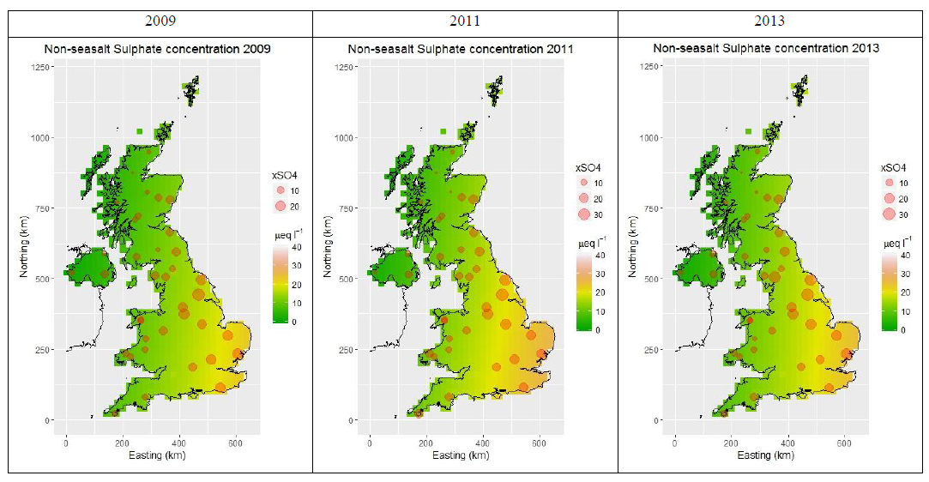
SPATIO-TEMPORAL Dependence
SPATIAL & SPATIO-TEMPORAL

Slide 13
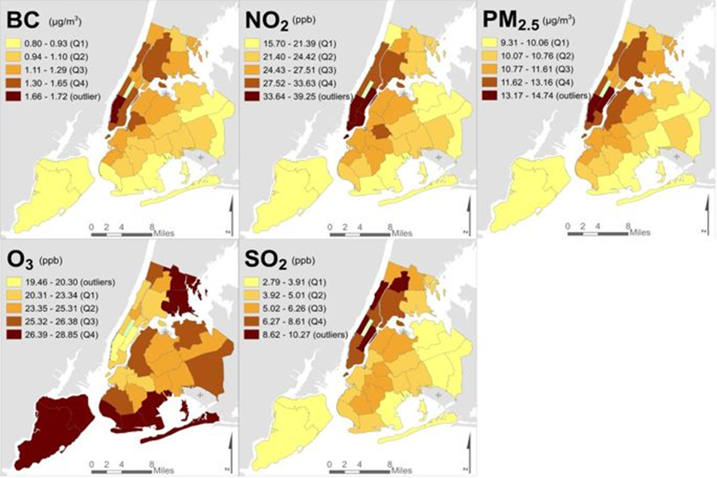
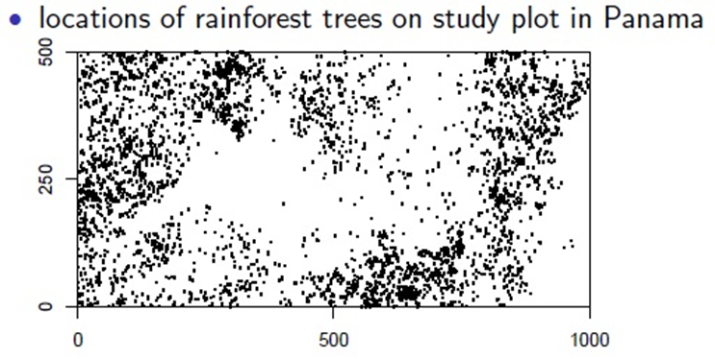
Broad class of models
SPATIAL & SPATIO-TEMPORAL
Appropriate modelling of time series which vary spatially
Or - understanding how spatial patterns evolve over time
Can we use temporal information to improve modelling in sparse/changing spatial datasets?
Methods depend on data
Are the data evenly or unevenly spaced in time? Over what scale (hourly, daily, monthly, annually – impacts on trends/seasonality)
Are the data geostatistical, areal units, point process?

Slide 14
Broad class of models
SPATIAL & SPATIO-TEMPORAL
Appropriate modelling of time series which vary spatially
Or - understanding how spatial patterns evolve over time
Can we use temporal information to improve modelling in sparse/changing spatial datasets?
Methods depend on data
Are the data evenly or unevenly spaced in time? Over what scale (hourly, daily, monthly, annually – impacts on trends/seasonality)
Are the data geostatistical, areal units, point process?
Big data -> computational costs
Sampling across space and time may not be equally abundant

Slide 15
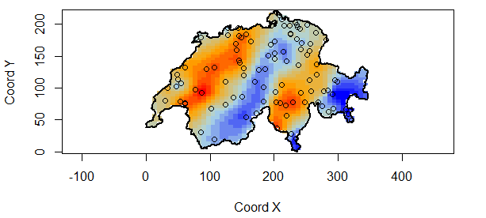

RECALL: geostatistics
SPATIAL & SPATIO-TEMPORAL
Stochastic (random) process - Variable of interest, Z, at locations set (s) within total space D
Swiss Rainfall Data
$$\left\{Z\left(s\right):s∈D\right\}$$
Locations s at which data could occur vary continuously over D.
But data are observed at a finite number of locations, denoted by:
z = {z(s₁), …, z(s_{m})}
i.e. a particular realisation of random variables Z(s)

Slide 16
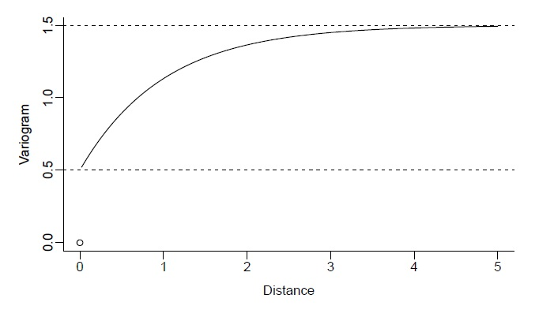
RECALL: THE VARIOGRAM
SPATIAL & SPATIO-TEMPORAL
Theoretical shape of the variogram
SILL (max variance between two zs)
NUGGET (intercept - limiting value towards 0)
PARTIAL SILL (sill minus nugget)
RANGE (distance at which sill is reached)
Notes:
These are the parameters

Slide 17

SPATIO-TEMPORAL GEOSTATISTICS
SPATIAL & SPATIO-TEMPORAL
Geostatistical process, Z, at locations set (s) within total space D
$$\left\{Z\left(s, t\right):s∈D, t∈1,…T\right\}$$
D, a continuous subset of 2 dimensional space.
T = 1,…,T – a set of regular time intervals. Data observed at m spatial locations
z = {z(s₁,t), …, z(s_{m},t)}
i.e. a multivariate time series dataset

Slide 18
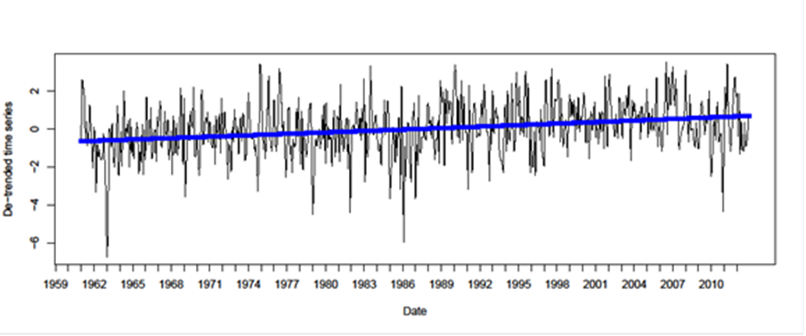

SPATIO-TEMPORAL GEOSTATISTICS
SPATIAL & SPATIO-TEMPORAL
Geostatistical process, Z, at locations set (s) within total space D
$$\left\{Z\left(s, t\right):s∈D, t∈1,…T\right\}$$
D, a continuous subset of 2 dimensional space.
T = 1,…,T – a set of regular time intervals. Data observed at m spatial locations
z = {z(s₁,t), …, z(s_{m},t)}
i.e. a multivariate time series dataset

Slide 19
A NOTE ON SOFTWARE
SPATIAL & SPATIO-TEMPORAL
spTimer
SpBayes
R-INLA/inlabru
OpenBUGS
JAGS
Software - Convenience vs Flexibility
Need to carefully assess and think about model inputs and outputs
(perhaps especially so with ‘off the shelf’ packages like geoR and spTimer because they are easy to implement!)
Computational time for large space-time datasets

Slide 20
A NOTE ON SOFTWARE
SPATIAL & SPATIO-TEMPORAL
spTimer
Uses an MCMC Gibbs sampler
Model formulations
Gaussian process model (GP)
Autoregressive model (AR)
Gaussian Predictive Process model (GPP)
Bakar & Sahu 2015 J Stat Soft

Slide 21
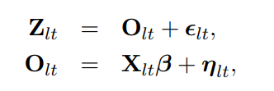
spTimer GAUSSIAN PROCESS (GP)
SPATIAL & SPATIO-TEMPORAL
Hierarchical model with independent Gaussian Process at each time point
Random effect that captures time & the space-time interactions
i.e. we accept that there is variation in space and time but time points are not correlated
A simple starting point!
Measured data, Z = true value O (at place s, time l & t) plus error
True value (at place s, time l & t) = covariates (varying in space and time) with regression coefficients beta and spatio-temporal random effects term eta
Bakar & Sahu 2015 J Stat Soft

Slide 22
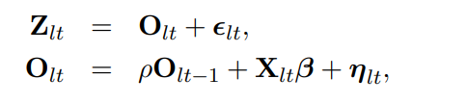
spTimer AUTOREGRESSIVE (AR)
SPATIAL & SPATIO-TEMPORAL
Hierarchical auto-regressive model
DOES include temporal correlation
Modelling current value of process O as a function of a scaled version of the previous value O at the previous time point (t – 1)
When rho = 0, the AR model = GP model
Everything else the same…
…except the temporal correlation term with parameter rho
Bakar & Sahu 2015 J Stat Soft

Slide 23
PLAUSIBLE PRIORS
SPATIAL & SPATIO-TEMPORAL
β ~ N(µ_{β}, V_{β})
Take on any value
Must be positive
Inverse-Gamma conjugate for variance. (Equivalent to Gamma distribution for precision parameter). Choice of (a,b) under research/debate.
Chosen over likely range of correlations; or by fixing these parameters
ρ ~ N(µ_{ρ}, V _{ρ})
σ² _{ε}, σ² _{η}~ Inverse-Gamma(a, b)
1/ σ² ~ Gamma(a, b)
φ, κ ~ Uniform(c, d)

Slide 24
SUMMARY
SPATIAL & SPATIO-TEMPORAL
Environmental data can be complex and abundant in space and/or time
Things often positively correlate in space and time reflecting underlying processes and (un)measured data
Implementing spatio-temporal models is an active area of research, including software development – some ‘off the shelf’ software may not be appropriate to your data structures
However, properly accounting for space and time structure in data can improve your model accuracy and inference

Slide 25
RESOURCES
SPATIAL & SPATIO-TEMPORAL
Bakar & Sahu (2015) spTimer: Spatio-Temporal Bayesian Modelling Using R. Journal of Statistical Software
Sahu & Mardia (2005) Recent Trends in Modeling Spatio-Temporal Data, Workshop Synthesis (and refs therein) http://www.soton.ac.uk/~sks/workshop/revsis.pdf
Using R-INLA/inlabru
Bachl et al. (2019) inlabru: an R package for Bayesian spatial modelling from ecological survey data. Methods in Ecology and Evolution. 10: 760-766.
Blangiardo & Cameletti (2015) Spatial and Spatio-temporal Bayesian Models with R-INLA
Zuur et al. (2017) Beginner’s Guide to Spatial, Temporal & Spatio-temporal ecological data analysis with R-INLA

